Slide 1
The 5 A’s of Website Evaluation
By Becky Burks

Slide 2

Our View of Society
Are all things done for the right reasons?
Is everyone honest?
Is everything that is written true?

Slide 3
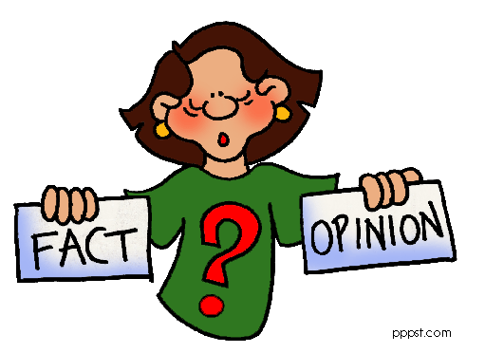
Fact and Opinion….
Opinion – expresses a person’s feelings toward a particular subject topic and cannot be proven. Opinions are usually constructed with words like best and worst.
Fact – information that can be proven

Slide 4

Publishing
Books, textbooks, magazines, journals: Material is submitted to a publishing company, and the company accepts the manuscript. Then, and editor reviews it. It is a long process and costs money.
Online Material: All you need is time and a site. No one reads over the material to insure it is correct. No one can make you remove a site with misinformation.

Slide 5

The Five A’s
Author
Age
Aim
Accuracy
Appearance

Slide 6

Author
Does the website have an author?
Are credentials listed?
Is there an email?
What makes this author an authority on the subject?
Is the author a company or an organization?
If there is no author, look at the URL
  .com = commercial
  .edu = education
  .gov = government
  .org = organization
  .net = network

Slide 7
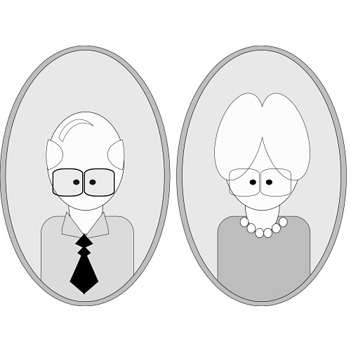
Age
Questions
Does the website include a date?
If so, what is the date?
If a date is posted, list whether the date was original date the website was posted or a revision date?

Slide 8
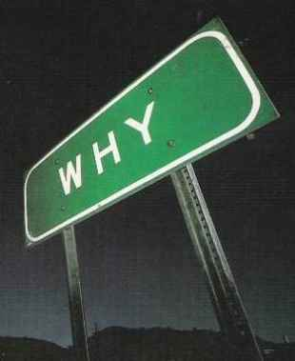
Aim
What is the purpose of the website?
  Communication – online messaging in the form of discussion boards, chat rooms, etc.
  Information – All types of info including the news, weather, the local park, or a product
  Education – Scholarly material
  Entertainment – online games, jokes, fun
  Commercial – Get you to buy something

Slide 9

Accuracy
Do you see any errors on the website?
Cross-check the information with other credible sites if needed

Slide 10
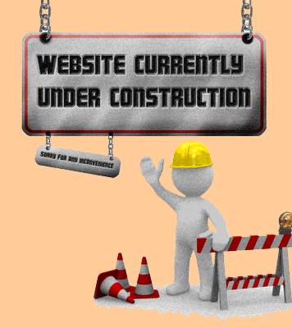
Appearance
Does the website look nice?
Is the website easy to use?
Does the site have a logo?

Slide 11
Your teacher has asked you to write a report on the career you want when you grow up. Choose the most reliable resource to use.
A – an anonymous webpage about careers
B – an interview with someone in that career
C – an adult’s opinion about various careers
D – a school-wide poll on favorite careers

Slide 12
Which of the following will not help determine the credibility of a website?
A - Identifying the organization responsible for the site
B - Checking the number of visits to the website
C - Finding the name of the author or authors
D - Looking at when the information was updated

Slide 13
Which of the following would be the least credible source of information about HIV/AIDS?
A – the website of an HIV/AIDS support group
B – the website of a person whose relative has HIV
C – the website of a national newspaper
D – the website of a government agency

Slide 14
Why is a website not necessarily a credible source of information?
A – because information can be published on a website without being proven
B – because not everyone has access to information published on websites
C – because it takes specialized skills to publish information on a website
D – because there are websites publishing information about every topic imaginable

Slide 15
Which of the following is important to know in order evaluate your sources?
A – Who is the author and what is his or her expertise?
B – Where is the author located?
C – Does the author have his or her own web page?
D – Is the author dead or alive?

