Slide 1
We are Tigers, hear us …
Responsibility
Optimism
Accountability
Respect
Notes:
Be sure to point out to explain the vocabulary of the terms to students:
Responsibility – each person in the bulding is responsible for their own actions. Each person should accept responsibility to model appropriate behavior.
Optimism – We are all here to learn. Each staff member and student should arrive each day being optimistic. We all have bad days, but we should all model the characteristic of optimism. School is a place where mistakes are an opportunity for learning.
Accountability – Every person must be accountable. Teachers must be prepared daily to teach, students must be held accountable to be prepared, complete assignments, and behave appropriately.
Respect – All people who enter HHS or attend an event at HHS should display respect toward staff, students, and guests.

Slide 2
ARRIVAL & DEPARTURE ROAR
Responsibility
Be on time & leave on time
If you arrive before 7:50 go directly to the gym
Wear appropriate dress code
Optimism
Come to school with a positive attitude ready to learn
Accountability
Be prepared with materials for class
Use language appropriate for school
Respect
Followed posted safety measures
ex. Speed Limit & One Way Signs

Slide 3
CAFETERIA ROAR
Responsibility
After getting lunch or breakfast choose a seat and stay there
Dump tray and put all trash in the garbage can
Optimism
Do the right thing without being asked
Accountability
Maintain an acceptable volume
Use language appropriate for school
Respect
Wait your turn
Be courteous to others (including cafeteria workers)
Have school ID ready
Be quiet if someone is announcing on the microphone

Slide 4
GYM ROAR FOR FORMAL EVENTS
Responsibility
Stay in the designated area until released
Stay off the gym floor during the event
Follow posted rules
Keep your area clean
Everyone must know the alma mater
Optimism
Represent your grade level and school in a positive manner
Show school spirit!
Accountability
Sit in your designated area and maintain an acceptable volume
Respect
Give full attention to the presenter or speaker
Be considerate of others

Slide 5
CLASSROOM ROAR
Responsibility
Be on time
Be prepared
BrBe responsible for your own assignments
Follow posted classroom procedures
Optimism
Always give your best effort
Be encouraging to others
Be an active participant
Accountability
Produce quality work
Turn in all assignments in a timely manner
Ask for help when you need it.
Respect
Treat others and their property with respect
Give attention to the teacher
Use kind words and actions to other students/staff

Slide 6
RESTROOM ROAR
Responsibility
Go, flush, wash, leave
Return to class promptly
If the restroom needs attention, contact the teacher
Optimism
Report vandalism and misbehavior promptly
Accountability
Keep the restroom clean
Go to the nearest restroom
Respect
Give others privacy and personal space
Be respectful of others’ time and needs

Slide 7
HALLWAY ROAR
Responsibility
Walk in an orderly fashion
Maintain an inside voice and use language appropriate for school
Report an inappropriate behavior
Optimism
Keep the hallways clean
Accountability
Go straight to your destination
Carry a valid hall pass
Respect
Be kind to your locker neighbor
Be respectful of other classes in session

Slide 8
TECHNOLOGY ROAR
Responsibility
Use cell phones in designated areas only
Use cell phones according to school policy
Know that computers are for academic use only
Optimism
Complete assignments to the best of your ability
Stay on task
Accountability
Keep your personal information off the internet
Ask for help if you experience problems
Respect
Leave the equipment the same as you found it
Follow acceptable use policies

Slide 9
BUS ROAR
Responsibility
Remain in seat
Keep head and hands inside the bus
Optimism
Be a positive role model for younger students
Help bus driver maintain safety
Accountability
Keep the bus clean
Pick up any trash you see
Respect
Use appropriate language
Respect others’ property

Slide 10
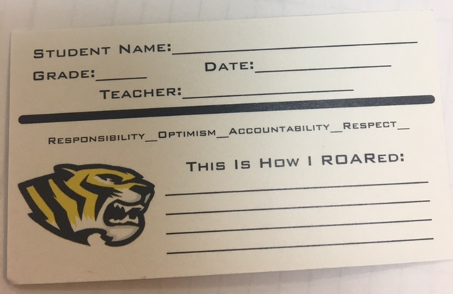
Acknowledgement/Reward
Verbal Praise will be given when students exhibit ROAR behavior!!
Students could also receive a ticket for prizes, celebrations or trips! Let’s ROAR!!

Slide 11
ROAR Matching Game
Divide into groups of 3-4 and match the expectations with the area
The group that gets the most correct wins!!!

